Slide 1
Writing large numbers in standard form
Task A: Writing large numbers in standard form
Without using a place value chart, convert the following into standard form.
= 1.5 × 10⁴
15 000
566 000 000
9 800 000 000
156 100
563 000 000 000 000 000
100 200 000 000
= 5.66 × 10⁸
= 9.8 × 10⁹
= 1.561 × 10⁵
= 5.63 × 10¹⁷
= 1.002 × 10¹¹
2) Three pupils we give 905 000 000 000 to convert to standard form. Identify where they made their error and give the correct answer.
905 000 000 000
Answer: 905 × 10⁹
905 000 000 000
Answer: 9.5 × 10¹¹
905 000 000 000
Answer: 9.05 × 10¹⁰
The first part of standard form must have a number between 1 and 10, including 1 and not including 10. (1 ≤ A < 10)
In order to correctly obtain 905 000 000 000, there must be a multiplication of powers of 10 to 9.05 not 9.5
Incorrectly counted the number of multiplications of 10. There are 11 multiplications of 10.
Correct: 9.05 × 10¹¹
3) Explain why standard form is important.
We write a number in standard form because it is easier, concise and more efficient to write numbers in this way.
It reduces errors. It would take too long to write huge numbers and there would be more room for error when writing a number in its ordinary form.
Standard form allows any number to be written using one standard approach i.e where A × 10^{n} and 1 ≤ A < 10 and n is an integer.
When writing in a concise form, it is easier to use in calculations.
‹#›

Slide 2
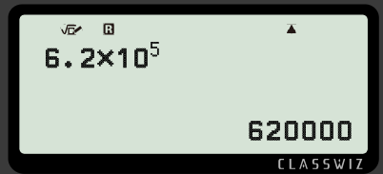
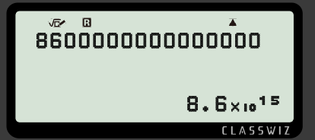
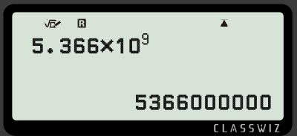
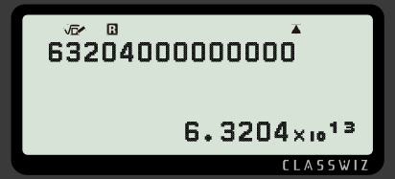
Writing large numbers in standard form
Task B: Standard form to ordinary
Write the following as ordinary numbers.
1.8 × 10³
1.39 × 10⁵
3.93 × 10⁷
4.413 × 10⁸
= 1 800
e) 8.02 × 10³
f) 5.001 × 10⁵ g) 1.2345 × 10⁷ h) 7.00004 × 10⁸
= 8020
= 139 000
= 500 100
= 39 300 000
= 12 345 000
= 441 300 000
= 700 004 000
Task C: Standard form on the calculator
Fill in the missing information.
a)
c)
b)
d)
2) Investigate when the number becomes so big that the calculator converts it into standard form.
Any integer on the screen which has more than 9 digits will be converted into standard form.
Mathematics in Education and Industry
v2.3

